Slide 1
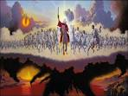
Who is the Lord’s great army?
Notes:
If I were to ask you to define the “Battle of Armageddon” in a few words, what would you say? (CLICK)

Slide 2
Out with the old (order)– In with the new (order)
The great controversy between Truth and Error,
right and wrong, God and Mammon,
The inauguration of Christ’s Kingdom, The overthrow of Satan’s rule
A great tribulation such as never was before

Slide 3
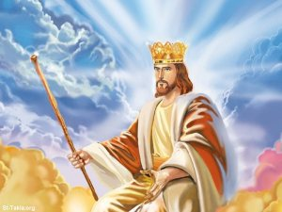
Notes:
The prophet Daniel declares that God's Representative, "Michael, shall stand up (or assume control) the great Prince which standeth for the children of" Israel. The word "Michael" signifies "He who is like God"-- the Godlike One.
Who’s side is Michael on? Who is he fighting for?
He will stand up for the salvation of God's people, for the rectification of error and wrong, for the establishment of right and truth, to bring to the world of mankind the great Kingdom of God, which has been preached from the days of Abraham.
Genesis 49:10: The sceptre (which represents the “right” to rule) shall not depart from Judah, nor a lawgiver from between his feet, until Shiloh come; and unto him shall the gathering of the people be.

Slide 4
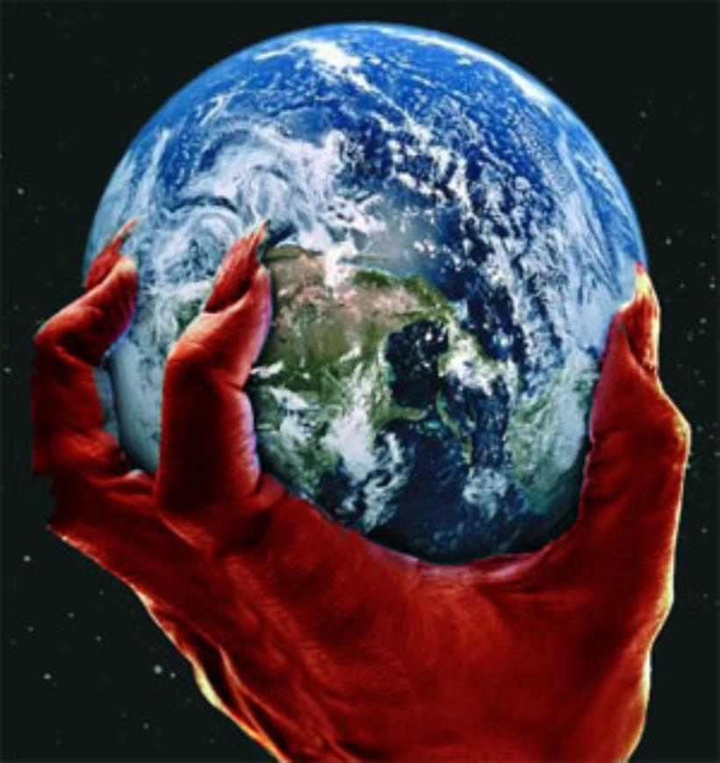
Notes:
And neither Satan, nor any of his minions will let go of this old order without a battle!

Slide 5
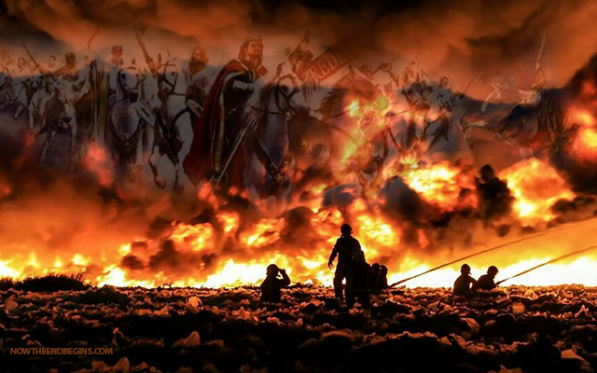
Notes:
According to the scriptures, this battle of Armageddon, this day of Jehovah, this day of vengeance, as it is variously called, is the result of Messiah’s Kingdom, all powerful, but invisible, rolling away the curse which has enslaved mankind for the past 6000 years. We read:
Matthew 24:21: For then shall be great tribulation, such as was not since the beginning of the world to this time, no, nor ever shall be.
Daniel 12:1: And at that time shall Michael stand up, the great prince which standeth for the children of thy people: and there shall be a time of trouble, such as never was since there was a nation even to that same time: and at that time thy people shall be delivered, every one that shall be found written in the book.
There have been many troublous times in our world’s history. The Civil War was a very dark period in American history. The French revolution was a time of suffering in France’s history. The American revolution; the infamous pandemic of bubonic plague, hit in 1347, killing a third of the human population. We can go on and on listing horrific troubles experienced by mankind since the fall of Adam.
Listen to this comment Bro. Russell makes in Volume 1 Page 307, “Small revolutions have caused trouble in every age; and this, so much greater than any previous revolution, is to be a time of trouble such as never was since there was a nation --no, nor ever shall be. Dan. 12:1; Matt. 24:21,22.” So why is the trouble prophesied in Daniel and Matthew greater than all preceding…a time of trouble such as never was preceding and never will be afterward? What makes this time of trouble so great? What does the word great mean? Great = Great in multitude or great in magnitude.
What time in history do you believe fulfills this prophecy…where in man’s history is the greatest time of trouble?

Slide 6
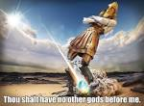
Notes:
Daniel 2:34: Thou sawest till that a stone was cut out without hands, which smote the image upon his feet that were of iron and clay, and brake them to piece
Daniel 2:45: Forasmuch as thou sawest that the stone was cut out of the mountain without hands, and that it brake in pieces the iron, the brass, the clay, the silver, and the gold…
We believe this stone represents Christ’s Kingdom in its infancy. Remember, after it strikes the image, it grows into a great mountain (or Kingdom). Daniel 2:35: Then was the iron, the clay, the brass, the silver, and the gold, broken to pieces together, and became like the chaff of the summer threshing floors; and the wind (The Great War) carried them away, that no place was found for them: and the stone that smote the image became a great mountain (kingdom), and filled the whole earth.
It is also our belief that this stone (Christ’s Kingdom) struck the image (the last of the Gentile kingdoms) in the year 1914 (which we believe was the end of the gentile lease of power). This was the initial explosion. We read Daniel 2:44: And in the days of these kings shall the God of heaven set up a kingdom, which shall never be destroyed: and the kingdom shall not be left to other people, but it shall break in pieces and consume all these kingdoms, and it shall stand for ever.
The great war (as it was called…not WWI) is the only time in earth’s history (up to that point) which we believe, accurately fits the prophecy of the great time of trouble such as never was before. In an effort to prove this point, let’s take a moment and set the stage for what the world was like just before 1914.

Slide 7
Notes:
You may be familiar with this excerpt taken from the book entitled, “The Guns of August” by Barbara Tuchman.
“So gorgeous was the spectacle on the May morning of 1910 when nine kings rode in the funeral of Edward 7 of England that the crowd, waiting in hushed and black-clad awe, could not keep back gasps of admiration. In scarlet and green and blue and purple, three by three (Click) the sovereigns rode through the palace gates, with plumed helmets, gold braid, crimson sashes, and jeweled orders flashing in the sun. After them came five heirs apparent, forty more imperial or royal highnesses, seven queens – four dowager and three regnant – and a scattering of special ambassadors from uncrowned countries. Together they represented seventy nations in the greatest assemblage of royalty and rank ever gathered in one place and, of its kind, the last. The muffled tongue of Big Ben tolled nine by the clock as the cortege left the palace, but on history’s clock it was sunset, and the sun of the old world was setting in a dying blaze of splendor never to be seen again.”
I am not sure that you and I can truly appreciate what the world was like before 1914. Could you imagine living in a world ruled by Kings and Queens. And believing, with the rest of the world, that those Kings and Queens ruled over you by Divine right and authority…and believing that whatever they did, was approved of God. This is what we call the “Doctrine of the Divine Right of Kings”.
Now let us take a moment to put into perspective what happened in 1914 and immediately after.

Slide 8
The Great War of 1914
The Great Time of Trouble
Notes:
Let’s read a couple of excerpts from the WORLD SCOPE ENCYCLOPEDIA 1951…on our bookshelf…A secular perspective.
World War I…(initially called “The ‘Great’ War”…”Great” time of trouble)
1. The assassination at Sarajevo and the bombardment of Belgrade thrust upon the world the first great mass conflict that it had ever known – a war which involved more peoples than ever before in the history of mankind.
2. Before the war was over 93 percent of the world’s population had been involved;
3. Never before (such as never was before) had so many men been engaged in one war, and never before had one war been so complex. Twentieth-century inventions had combined to make the battle severer than ever before.
At the end of the “first part” of the great war, all kings had abdicated (abdicate = left, renounced) their thrones. As an example, on November 9, 1918, the Kaiser of Germany, faced with no alternative, renounced his throne; the following dawn he left for The Netherlands and the life of an exile. That’s because the King of Kings and Lord of Lords was now on the scene. So long as these governments would be here, they and Messiah's Kingdom could not cooperate. The Gentile governments are based on selfishness and coercion; Christ's Kingdom will be based on justice, love, mercy, under the Prince of Peace. The two could not rule at the same time. Hence it was foretold that Messiah at His Second Coming will first bind the "strong man" of Gentile supremacy, and on the ruins of earthly dominions establish a righteous Government. R5526 P 5
Thus we have the beginning of the greatest time of trouble ever experienced in the history of mankind.
Can anybody tell me what caused this great time of trouble? Why did it not come sooner…why not in 1630 or perhaps 1825?
Knowledge…Knowledge of what?
The Lord declares that He has a hand in these matters that are a natural outcome of human selfishness, aggressiveness and greed. The Lord has to do with all this, in that at the appropriate time He granted to the world the knowledge which is stirring them up. In other words, men with sin and selfishness in their hearts are not in a position to use knowledge wisely, rightly. R5526: 7
While the Lord has been doing this work, we are not to think that He is pitting these nations against each other. He has permitted them to work out their selfish propensities, and the result is strife. Knowledge is doing this-- bringing on the restless social condition. R5526 Keep this in mind…we will be discussing it in more detail later.

Slide 9
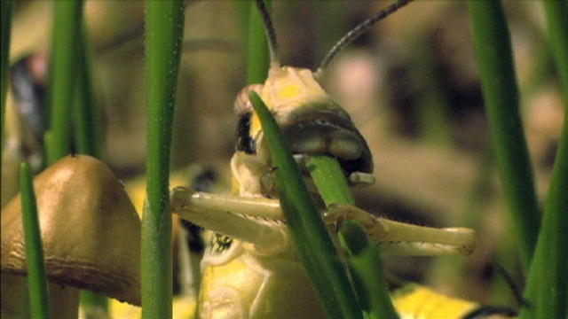
Who is the Lord’s great army?
Notes:
Closely associated with this Great time of trouble, in the book of Joel, chapter two, we read about a peculiar army, referred to as the Lord’s Great Army...in the possessive sense. This army is symbolized by a particular insect. Does anybody know what insect is depicted as the Lord’s Great Army? (Click)
What is it about the locust? Why would the Lord use this insect to picture his great army? Well, let us take a look at the second chapter of Joel and see what we find.

Slide 10
JOEL: CHAPTER 2
Joel 2:1: Blow ye the trumpet in Zion, and sound an alarm in my holy mountain: let all the inhabitants of the land tremble: for the day of the LORD cometh, for it is nigh at hand;
Notes:
Joel 2:1: Blow ye the trumpet in Zion, and sound an alarm in my holy mountain: let all the inhabitants of the land tremble: for the day of the LORD cometh, for it is nigh at hand;

Slide 11
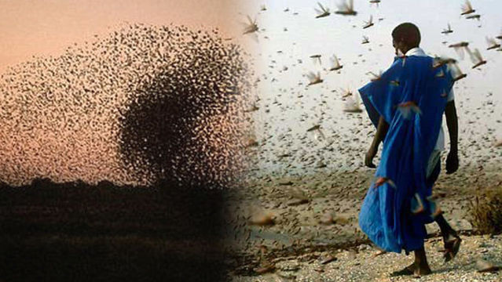
Joel 2:2: A day of darkness and of gloominess, a day of clouds and of thick darkness, as the morning spread upon the mountains: a great people and a strong; there hath not been ever the like, neither shall be any more after it, even to the years of many generations.
Notes:
Joel 2:2: A day of darkness and of gloominess, a day of clouds and of thick darkness, as the morning spread upon the mountains: a great people and a strong;
That’s right…a swarm of locusts are innumerable; they exceed computation: the Hebrews called them 'the countless,' and the Arabs knew them as 'the darkeners of the sun.' Innumerable as the drops of water or the sands of the seashore, their flight obscures the sun and casts a thick shadow on the earth ( Exodus 10:15 ; Judges 6:5 ; 7:12 ; Jeremiah 46:23 ; Joel 2:10 ).
there hath not been ever the like, neither shall be any more after it, even to the years of many generations. Does the last half of this scripture have a familiar sound to you?…what other scripture sounds like this?
Matthew 24:21: For then shall be great tribulation, such as was not since the beginning of the world to this time, no, nor ever shall be. …let’s read both scriptures again.
Dan 12:1: …and there shall be a time of trouble, such as never was since there was a nation even to that same time: We think this may be our first clue as to where to look for the Lord’s Great Army
Exodus 10:13: And Moses stretched forth his rod over the land of Egypt, and the LORD brought an east wind upon the land all that day, and all that night; and when it was morning, the east wind brought the locusts.
Exodus 10:14: And the locusts went up over all the land of Egypt, and rested in all the coasts of Egypt: very grievous were they; before them there were no such locusts as they, neither after them shall be such.
Exodus 10:15: For they covered the face of the whole earth, so that the land was darkened; and they did eat every herb of the land, and all the fruit of the trees which the hail had left: and there remained not any green thing in the trees, or in the herbs of the field, through all the land of Egypt.
The locust is a well‐known insect, of the grasshopper family, which commits terrible ravages on vegetation in the countries which it visits. Unable to guide their own flight, though capable of crossing large spaces, they are at the mercy of the wind, which bears them as blind instruments of Providence to the doomed region given over to them for the time. Woe to the countries beneath them if the wind fall and let them alight!

Slide 12
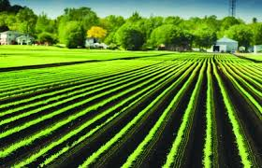
Joel 2:3: A fire devoureth before them; and behind them a flame burneth: the land is as the garden of Eden before them…
Notes:
Joel 2:3: A fire devoureth before them; and behind them a flame burneth: the land is as the garden of Eden before them, (click)

Slide 13
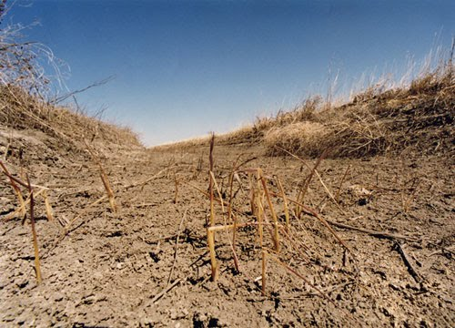
Joel 2:3 ...and behind them a desolate wilderness; yea, and nothing shall escape them.
Notes:
Joel 2:3 …and behind them a desolate wilderness; yea, and nothing shall escape them.
The devastations locusts make in Eastern lands are often very appalling. Their invasions are the heaviest calamites that can befall a country.

Slide 14
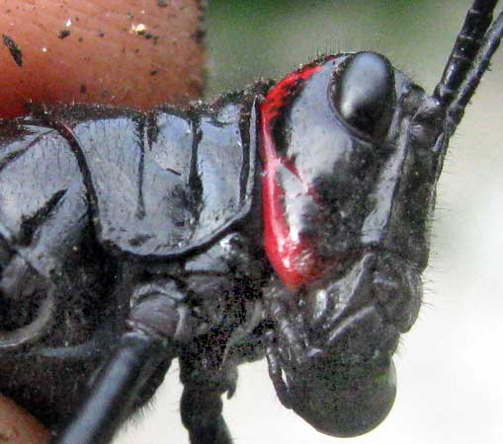
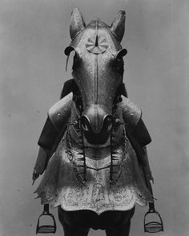
Joel 2:4: The appearance of them is as the appearance of horses; and as horsemen, so shall they run.
Notes:
Take a good look at the locust on the left and the war horse, clad in battle armor on the right.
Joel 2:4: The appearance of them is as the appearance of horses; and as horsemen, so shall they run.
Revelation 9:7: And the shapes of the locusts were like unto horses prepared unto battle; and on their heads were as it were crowns like gold, and their faces were as the faces of men.
Take another look at the locust…it almost appears to have a face of a man.

Slide 15
JOEL: CHAPTER 2
Joel 2:5: Like the noise of chariots on the tops of mountains shall they leap, like the noise of a flame of fire that devoureth the stubble, as a strong people set in battle array.
Joel 2:6: Before their face the people shall be much pained: all faces shall gather blackness.
Notes:
Joel 2:5: Like the noise of chariots on the tops of mountains shall they leap, like the noise of a flame of fire that devoureth the stubble, as a strong people set in battle array.
Joel 2:6: Before their face the people shall be much pained: all faces shall gather blackness.
Swarms of locust in flight have been described as sounding like a crackling fire, rain and the noise of chariots. At their approach the people are in anguish; all faces lose their colour'

Slide 16
JOEL: CHAPTER 2
Joel 2:7: They shall run like mighty men; they shall climb the wall like men of war; and they shall march every one on his ways, and they shall not break their ranks:
Joel 2:8: Neither shall one thrust another; they shall walk every one in his path: and when they fall upon the sword, they shall not be wounded.
Notes:
Joel 2:7: They shall run like mighty men; they shall climb the wall like men of war; and they shall march every one on his ways, and they shall not break their ranks:
Joel 2:8: Neither shall one thrust another; they shall walk every one in his path: and when they fall upon the sword, they shall not be wounded.
Locusts spread their wings and fly so close together as to appear like one compact moving mass. Their flight is slow and uniform and they don’t thrust another…no they do not bump into each another.

Slide 17
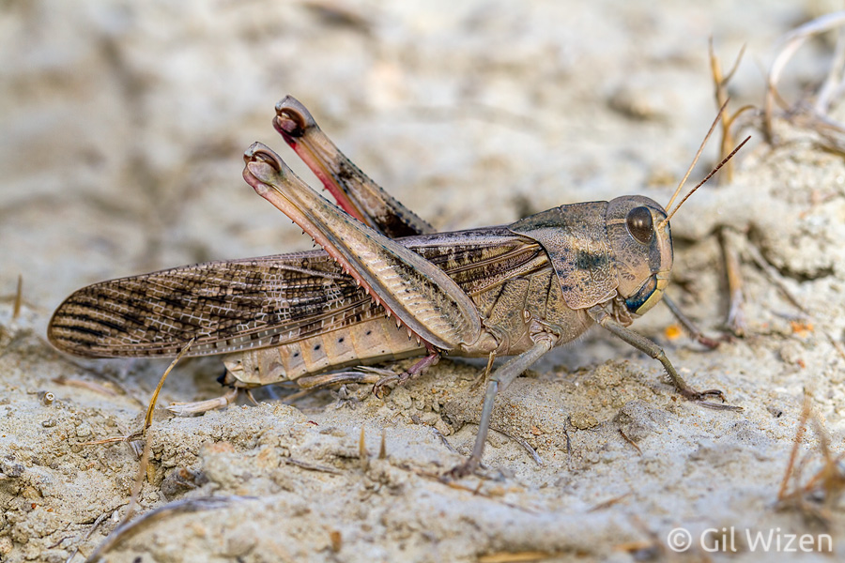
Joel 2:9: They shall run to and fro in the city; they shall run upon the wall, they shall climb up upon the houses; they shall enter in at the windows like a thief.
Notes:
Joel 2:9: They shall run to and fro in the city; they shall run upon the wall, they shall climb up upon the houses; they shall enter in at the windows like a thief.
If a door or a window be open, locusts enter and destroy everything of wood in the house. Every terrace, court, and inner chamber is filled with them in a moment.

Slide 18
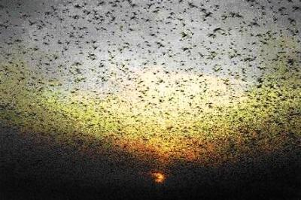
Joel 2:10: The earth shall quake before them; the heavens shall tremble: the sun and the moon shall be dark, and the stars shall withdraw their shining:
Notes:
Joel 2:10: The earth shall quake before them; the heavens shall tremble: the sun and the moon shall be dark, and the stars shall withdraw their shining:
Arabs knew locusts as 'the darkeners’ of the sun

Slide 19
JOEL: CHAPTER 2
Joel 2:11: And the LORD shall utter his voice before his army: for his camp is very great: for he is strong that executeth his word: for the day of the LORD is great and very terrible; and who can abide it?
Joel 2:12: Therefore also now, saith the LORD, turn ye even to me with all your heart, and with fasting, and with weeping, and with mourning:
Notes:
Joel 2:11: And the LORD shall utter his voice before his army: for his camp is very great: for he is strong that executeth his word: for the day of the LORD is great and very terrible; and who can abide it?
Joel 2:12: ¶Therefore also now, saith the LORD, turn ye even to me with all your heart, and with fasting, and with weeping, and with mourning:
Notice in verse 11 that this great army is referred to in the possessive sense…”His Army”. It is also referred to as “My Great Army” in verse 25…this is where we get the term, “The Lord’s Great Army.” From what we have seen so far, this army seems to be destructive, so why would it be referred to as, “The Lord’s”. Let’s think about that for a little bit and stop here for now.
Listen to this excerpt taken from the 4th volume forward. (D xi) We read: The symbolism of Scripture, rightly understood, is very forceful, and there is always a close resemblance between the symbol itself and the thing symbolized.

Slide 20
Revelation 16:13: And I saw three unclean spirits like frogs come out of the mouth of the dragon, and out of the mouth of the beast, and out of the mouth of the false prophet.
Revelation 16:14: For they are the spirits of devils, working miracles, which go forth unto the kings of the earth and of the whole world, to gather them to the battle of that great day of God Almighty.
Revelation 16:15: Behold, I come as a thief. Blessed is he that watcheth, and keepeth his garments, lest he walk naked, and they see his shame.
Revelation 16:16: And he gathered them together into a place called in the Hebrew tongue Armageddon.
Notes:
Keeping this thought in mind let’s step away, momentarily, from the second chapter of Joel, the Locusts, and the Lord’s Great Army and take a look at Revelation 16:13-16 and see an example of how the symbol in this scripture resembles the thing symbolized. (particularly focusing on the frogs)
Revelation of John 16:13: And I saw three unclean spirits like frogs come out of the mouth of the dragon, and out of the mouth of the beast, and out of the mouth of the false prophet.
Revelation of John 16:14: For they are the spirits of devils, working miracles, which go forth unto the kings of the earth and of the whole world, to gather them to the battle of that great day of God Almighty.
Revelation of John 16:15: Behold, I come as a thief. Blessed is he that watcheth, and keepeth his garments, lest he walk naked, and they see his shame.
Revelation of John 16:16: And he gathered them together into a place called in the Hebrew tongue Armageddon.

Slide 21
Revelation 16:13: And I saw three unclean spirits (false doctrines) like frogs come out of the mouth of the dragon (civil power), and out of the mouth of the beast (Papacy), and out of the mouth of the false prophet (protestant federation of churches – evangelical alliance).
Revelation 16:14: For they are the spirits of devils (false doctrines), working miracles, which go forth unto the kings of the earth and of the whole world, to gather them to the battle of that great day of God Almighty.
Revelation 16:15: Behold, I come as a thief. Blessed is he that watcheth, and keepeth his garments, lest he walk naked, and they see his shame.
Revelation 16:16: And he gathered them together into a place called in the Hebrew tongue Armageddon.
Notes:
Now, let us read these scriptures along with the interpretations as we understand them.
Revelation of John 16:13: And I saw three unclean spirits (false doctrines) like frogs come out of the mouth of the dragon (civil power), and out of the mouth of the beast (papacy), and out of the mouth of the false prophet (protestant federation of churches – evangelical alliance).
Revelation of John 16:14: For they are the spirits of devils (false doctrines), working miracles, which go forth unto the kings of the earth and of the whole world, to gather them to the battle of that great day of God Almighty.
Revelation of John 16:15: Behold, I come as a thief. Blessed is he that watcheth, and keepeth his garments, lest he walk naked, and they see his shame.
Revelation of John 16:16: And he gathered them together into a place called in the Hebrew tongue Armageddon.
When the holy Spirit uses a frog to represent certain false doctrines or teachings, we may be sure that the application will fit well. So how are these three false doctrines similar to frogs, or “like frogs”? What were the civil powers, papacy and the protestant federation of churches uttering falsely that could be aptly symbolized by a frog? Well, let us take a look at the characteristics of frogs to see what we come up with.

Slide 22
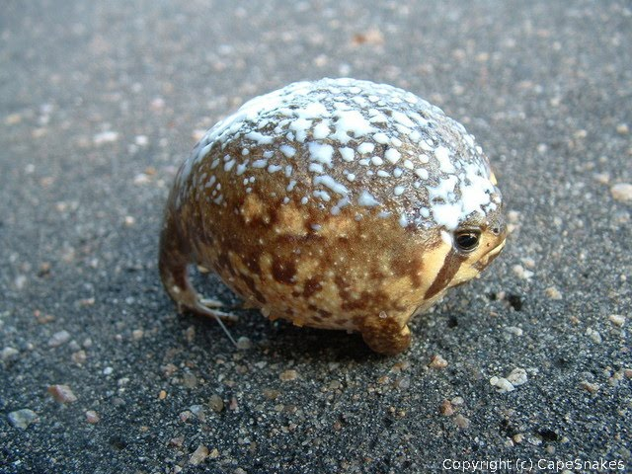
1. Puffed up = pomposity, boastfulness or bombast
Notes:
First, while a frog is a small creature, yet it puffs itself up until it almost bursts with the effort to be somebody. This represents pomposity, boastfulness or bombast = (high-sounding language with little meaning, used to impress people.)

Slide 23
2. Wise Look = an air of wisdom and knowledge
Notes:
Second, a frog has a very wise look, even though it does not know very much. This represents an air of superior wisdom and knowledge.

Slide 24
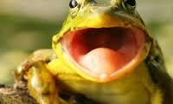
3. Croaking = false declarations
Notes:
Third, a frog croaks whenever it utters a sound. This croaking represents false declarations that if any fail to obey the councils of the dragon (civil powers), the beast (papacy) and the image of the beast (the protestant federation of churches), dire results will follow.

Slide 25
We are the leaders
We have the answers
If you don’t listen to us…
bad things will happen to you
Notes:
The croaking of the frog spirits, or doctrines, will gather the kings and princes, financial, political, religious and industrial into one great army.
That’s right…it is these three false doctrines which will gather the kings and the world to the battle of Armageddon. How so? Perhaps you can discuss this during fellowship.
Revelation of John 16:14: For they are the spirits of devils (false doctrines), working miracles, which go forth unto the kings of the earth and of the whole world, to gather them to the battle of that great day of God Almighty.
(May not read): The spirit of fear, inspired by the croaking, will scourge the passions of otherwise good and reasonable men to fury--desperation. In their blind following of these evil spirits, evil doctrines, they will be ready to sacrifice life and everything on what they mistakenly suppose is the altar of Justice, Truth and Righteousness under a Divine arrangement. (D foreword xiii)

Slide 26
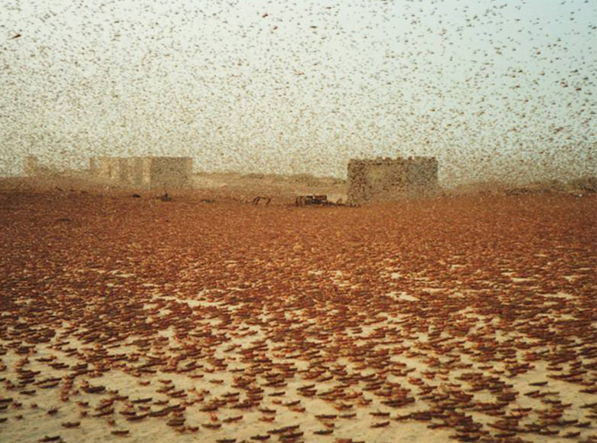
Who is the Lord’s great army?
Notes:
Now that we have looked at an example of how the characteristics of frogs are used in scripture to symbolize false teachings, let us return to the second chapter of Joel and see how locusts are used to symbolize the Lord’s Great Army.
Remember the excerpt we read earlier from the fourth volume forward, “The symbolism of Scripture, rightly understood, is very forceful, and there is always a close resemblance between the symbol itself and the thing symbolized.”

Slide 27
JOEL: CHAPTER 2
Joel 2:1: Blow ye the trumpet in Zion, and sound an alarm in my holy mountain: let all the inhabitants of the land tremble: for the day of the LORD cometh, for it is nigh at hand;
Trumpet …………..
Knowledge and Liberty
Zion ………………….
Nominal Kingdom of God
Holy Mountain …
Christendom
Day of the LORD…
Time of Trouble/Armageddon
Notes:
The first scripture in the second chapter of Joel talks about how all of this trouble gets started.
Joel 2:1: Blow ye the trumpet in Zion, and sound an alarm in my holy mountain: let all the inhabitants of the land tremble: for the day of the LORD cometh, for it is nigh at hand;
What does a Trumpet often signify in scripture? (Click)
What does Zion represent? (Click)
What is the Holy Mountain? (Click)
What is The Day of The LORD? (Click)
Trumpet = Jer 6:17: Hearken to the sound of the (watchman’s)
Zion = The Nominal Kingdom of God (D241)
Holy Mountain = Christendom, professed kingdom of the Lord. (D540, A318)
Day Of The LORD = Armageddon

Slide 28
Selfishness
Triumvirate of evil power
Knowledge
Liberty
Notes:
In chemistry it is frequently found that some useful and beneficial elements suddenly become rank poison by the change of proportions. So it is with the blessings of knowledge and liberty when compounded with selfishness. In certain proportions this combination has rendered valuable service to humanity, but the recent great increase of knowledge instead of exalting knowledge to the seat of power, has enthroned selfishness. Selfishness dominates, and uses knowledge and liberty as its servants. This combination is now ruling the world; and even its valuable elements are rendered enemies of righteousness and peace by reason of selfishness being in control. Under these conditions knowledge as the servant of selfishness is most active in serving selfish interests, and liberty controlled by selfishness threatens to become self-license, regardless of the rights and liberties of others. Under present conditions therefore, selfishness (controlling), knowledge and liberty constitute a Triumvirate of evil power which is now ruling and crushing Christendom---D308
In other words, men with sin and selfishness in their hearts are not in the position to use knowledge and liberty wisely. R5526
This is why the time of trouble did not begin sooner than it did…the selfishness of man was always there since the fall of Adam, but the increase of knowledge and liberty were not.
Daniel 12:4: But thou, O Daniel, shut up the words, and seal the book, even to the time of the end: many shall run to and fro, and knowledge shall be increased.

Slide 29
IS THIS OUR CLUE?
Joel 2:2: A day of darkness and of gloominess, a day of clouds and of thick darkness, as the morning spread upon the mountains: a great people and a strong; there hath not been ever the like, neither shall be any more after it, even to the years of many generations.
Matthew 24:21: For then shall be great tribulation, such as was not since the beginning of the world to this time, no, nor ever shall be.
Dan 12:1: …and there shall be a time of trouble, such as never was since there was a nation even to that same time:
Notes:
Joel 2:2: A day of darkness and of gloominess, a day of clouds and of thick darkness, as the morning spread upon the mountains: a great people and a strong; there hath not been ever the like, neither shall be any more after it, even to the years of many generations.
This second verse of Joel, chapter two, has a striking similarity to Matthew 21:21 and Daniel 12:1, which speak of the great time of trouble;
Matthew 24:21: For then shall be great tribulation, such as was not since the beginning of the world to this time, no, nor ever shall be.
Dan 12:1: …and there shall be a time of trouble, such as never was since there was a nation even to that same time:
Looking at these scriptures, it would appear as though the Lord’s great army and the time of trouble are somehow linked. That you can’t have one without the other. Therefore, if we believe the time of trouble had its beginning in 1914, then we would expect to find the Lord’s Great Army there as well. But who are they? Do you think they are the great armies of Europe who fought in the World War?

Slide 30
JOEL: CHAPTER 2
Joel 2:3 A fire devoureth before them; and behind them a flame burneth: the land is as the Garden of Eden, and behind them a desolate wilderness; yea, and nothing shall escape them.
Joel 2:4: The appearance of them is as the appearance of horses; and as horsemen, so shall they run.
Fire ……..……………….
Destruction
Land….………………….
(Earth) The Present Social Order
Horses….………………….
Doctrines
Horsemen …………….
Teachers of False Doctrines
Notes:
Joel 2:3: A fire devoureth before them; and behind them a flame burneth: the land is as the garden of Eden before them, and behind them a desolate wilderness: yea, and nothing shall escape them.
Joel 2:4: The appearance of them is as the appearance of horses; and as horsemen, so shall they run. Click)
What does fire often signify in scripture? (Click)
Fire = Destruction (A318) Flame = Destruction
What do you think Land signifies? (Click)
Land = (earth) or society
How about horses? (Click)
Horses = Doctrines R 622:7, = old false doctrinal hobbies C 316m
And horsemen? (Click)
Horsemen = The Teachers of False Doctrine R622:7; The great leaders in False Doctrines C316m
According to this description, The Lord’s Great Army is very destructive. But what are they destroying? They are destroying the (Land) or the present social order…remember, the old selfish order must be torn down before Christ’s kingdom of righteousness can be established.
Also, this army has the “appearance” of horses (or doctrines). What could this mean? We think it means that the Lord’s Great Army has teachings or ideas (another word for doctrine is teaching), but these teachings only have an appearance of being truthful. They are, however false teachings based upon selfish ideas, which do not consider the rights of others…only their own perceived rights. Remember the Triumvirate of Evil…knowledge as the servant of selfishness is most active in serving selfish interests, and liberty controlled by selfishness threatens to become self-license, regardless of the rights and liberties of others.

Slide 31
JOEL: CHAPTER 2
Joel 2:5: Like the noise of chariots on the tops of mountains shall they leap, like the noise of a flame of fire that devoureth the stubble, as a strong people set in battle array.
Joel 2:6: Before their face the people shall be much pained: all faces shall gather blackness.
Notes:
Joel 2:5: Like the noise of chariots on the tops of mountains shall they leap, like the noise of a flame of fire that devoureth the stubble, as a strong people set in battle array.
Joel 2:6: Before their face the people shall be much pained: all faces shall gather blackness.

Slide 32
JOEL: CHAPTER 2
Joel 2:7: They shall run like mighty men; they shall climb the wall like men of war; and they shall march every one on his ways, and they shall not break their ranks:
Joel 2:8: Neither shall one thrust another; they shall walk every one in his path: and when they fall upon the sword, they shall not be wounded.
Notes:
Joel 2:7: They shall run like mighty men; they shall climb the wall like men of war; and they shall march every one on his ways, and they shall not break their ranks:
Joel 2:8: Neither shall one thrust another; they shall walk every one in his path: and when they fall upon the sword, they shall not be wounded.
The Lord’s Great Army is not concerned about walls (or Barriers like Civil Authority). They do not break their ranks, nor to they thrust another…this seams to say that they do not interfere with each other; they do not oppose one another…they do not get in one another's way.

Slide 33
JOEL: CHAPTER 2
Joel 2:9: They shall run to and fro in the city; they shall run upon the wall, they shall climb up upon the houses; they shall enter in at the windows like a thief.
Joel 2:10: The earth shall quake before them; the heavens shall tremble: the sun and the moon shall be dark, and the stars shall withdraw their shining:
Notes:
Joel 2:9: They shall run to and fro in the city; they shall run upon the wall, they shall climb up upon the houses; they shall enter in at the windows like a thief.
Joel 2:10: The earth shall quake before them; the heavens shall tremble: the sun and the moon shall be dark, and the stars shall withdraw their shining:
This seems to tell us that nothing will stop the Lord’s Great Army.

Slide 34
JOEL: CHAPTER 2
Joel 2:11: And the LORD shall utter his voice before his army: for his camp is very great: for he is strong that executeth his word: for the day of the LORD is great and very terrible; and who can abide it?
Joel 2:12: Therefore also now, saith the LORD, turn ye even to me with all your heart, and with fasting, and with weeping, and with mourning:
Notes:
Joel 2:11: And the LORD shall utter his voice before his army: for his camp is very great: for he is strong that executeth his word: for the day of the LORD is great and very terrible; and who can abide it?
Joel 2:12: ¶Therefore also now, saith the LORD, turn ye even to me with all your heart, and with fasting, and with weeping, and with mourning:
This army is referred to as “his” or “The Lord’s” in the possessive sense, not because they are on his side, but because they are accomplishing the work necessary for him to establish his righteous kingdom. The Lord only supervises and causes the wrath of man to praise him.
By the way, do you think the Lord wants this trouble?
Listen to this excerpt taken from one of the volumes, “The trouble of this Day of the Lord would not come, could not come, if the principles of God's law were observed to any considerable extent. That law briefly summed up is--Thou shalt love the Lord thy God with all thy heart, and thy neighbor as thyself. ( Matt. 22:37-39) It is because the depraved or carnal mind is opposed to this law of God, and is not subject to it, that, as a natural consequence, the trouble will come, as reaping after sowing.”
So “Who Is The Lord’s Great Army”?
Do you think we are looking for one singular group of revolutionaries?

Slide 35
Who is the Lord’s great army?
Anarchists, Socialists, and hot-headed radicals of every school of reason and unreason, will be in the forefront of that battle. He who has any knowledge of army life knows that a great army is composed of all classes. (D Forward)
He it is that will fight the armageddon Battle, and his agency will be that peculiar army—all classes. (D Forward)

Slide 36
Who is the Lord’s great army?
Anarchists may be part of the Lord's great army in that He will supervise their campaign. R5526
The armies of Europe? Perhaps not, but the willingness of the people is an important factor in connection with any war.

Slide 37
Who is the Lord’s great army?
The Lord speaks of the anarchists as "His great army" in a figurative way, just as He speaks of the caterpillars, which are used figuratively to represent His army. The saints will not be in that army at all. The Lord has used even the Devil as His agent, and "the wrath of man to praise Him." Anarchists may be part of the Lord's great army in that He will supervise their campaign.
R5526

Slide 38
Who is the Lord’s great army?
The present terrible war is not the great Time of Trouble in the fullest sense of the word, but merely its forerunner. The great Time of Trouble of the Scriptures will be brought on by anarchy--the general uprising of the people; as the Prophet says, "every man's hand against his neighbor, no peace to him that goeth out or to him that cometh in."--`Zech 8:10
R5526:6
Notes:
(D XV) Anarchists, Socialists, and hot-headed radicals of every school of reason and unreason, will be in the forefront of that battle. He who has any knowlidge of army life knows that a great army is composed of all classes.
NOTES: It is everywhere described as a dark day of intense trouble and distress and perplexity upon mankind. And what wonder that a revolution of such proportions, and necessitating such great changes, should cause trouble.
NOTES: While God's message to the Church has been, "Present your bodies a living sacrifice”Rom. 12:1), his message to the world has been, "Keep thy tongue from evil, and thy lips from speaking guile; depart from evil and do good; seek peace and pursue it." (Psa. 34:13,14) Few have heeded either message. Only a little flock sacrificed; and as for the world, though it nailed up the motto, "Honesty is the best policy," it has neglected in general to practice it. It heeded rather the voice of avarice--Get all you can of riches and honor and power in this world, no matter what the method by which you obtain it, and no matter who loses by your gain. In a word, the trouble of this Day of the Lord would not come, could not come, if the principles of God's law were observed to any considerable extent. That law briefly summed up is--Thou shalt love the Lord thy God with all thy heart, and thy neighbor as thyself. (Matt. 22:37-39) It is because the depraved or carnal mind is opposed to this law of God, and is not subject to it, that, as a natural consequence, the trouble will come, as reaping after sowing.
NOTE: nobles, will result in the anarchy which will doubtless prevail throughout Europe--and extend to every nation, as the Bible predicts. We understand that Christ's Kingdom is associated with this in the sense that Christ is about to take to Himself His great power and reign. The Lord speaks of the anarchists as "His great army" in a figurative way, just as He speaks of the caterpillars, which are used figuratively to represent His army. The saints will not be in that army at all. The Lord has used even the Devil as His agent, and "the wrath of man to praise Him." Anarchists may be part of the Lord's great army in that He will supervise their campaign. R5526
The present terrible war is not the great Time of Trouble in the fullest sense of the word, but merely its forerunner. The great Time of Trouble of the Scriptures will be brought on by anarchy--the general uprising of the people; as the Prophet says, "every man's hand against his neighbor, no peace to him that goeth out or to him that cometh in."--`Zechariah 8:10`. R5526:6
THESE ARE Explanations OF WHO THE ARMY IS:
We know in advance that the Lord is on the side of the people. He it is that will fight the armageddon Battle, and his agency will be that peculiar army—all classes. D forward xvi
The same principle will apply in the coming Battle of Armageddon. God’s side of that battle will be the people’s side; and that very nondescript host, the people, will be pitted at the beginning of the battle. D forward XV
WHAT CAUSES THE TROUBLE….KNOWLEDGE:
But as the time drew near in which Jehovah designed to bless the world through a Restitution at the hands of Messiah, he began to lift up the veil of ignorance and superstition, through modern facilities and inventions; and with these came the general elevation of the people and the decreasing power of earthly rulers. No longer is the wealth of the world in the hands of its kings, but chiefly among the people. A312

Slide 39
Notes:
The sword of truth, already sharpened, is to smite every evil system and custom--civil, social and ecclesiastical. Nay, more, we can see that the smiting is commenced: freedom of thought, and human rights, civil and religious, long lost sight of under kings and emperors, popes, synods, councils, traditions and creeds, are being appreciated and asserted as never before. The internal conflict is already fomenting: it will ere long break forth as a consuming fire, and human systems, and errors, which for centuries have fettered truth and oppressed the groaning creation, must melt before it. Yes, truth--and widespread and increasing knowledge of it--is the sword which is perplexing and wounding the heads over many countries. (Psa. 110:6) Yet in this trouble what a blessing is disguised: It will prepare mankind for a fuller appreciation of righteousness and truth, under the reign of the King of Righteousness. As men shall eventually come to realize that justice is laid to the line and righteousness to the plummet (Isa 28:17), they will also learn that the strict rules of justice alone can secure the blessings which all desire. And, thoroughly disheartened with their own ways and the miserable fruitage of selfishness, they will welcome and gladly submit to the righteous authority which takes the control; and thus, as it is written, (Click)

Slide 40
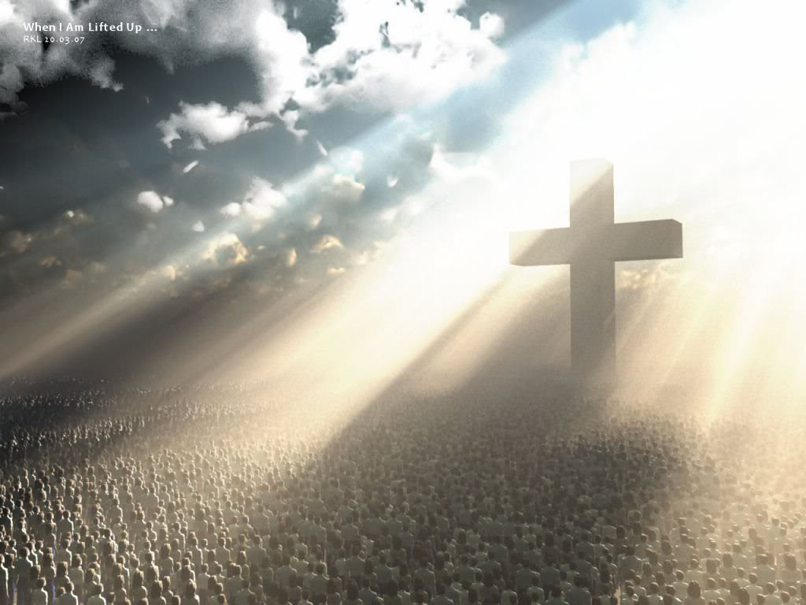
Notes:
"The desire of all nations shall come"--the Kingdom of God, under the absolute and unlimited control of Jehovah's Anointed. B102
Joel 2:25: And I will restore to you the years that the locust hath eaten, the cankerworm, and the caterpiller, and the palmerworm, my great army which I sent among you.
Joel 2:26: And ye shall eat in plenty, and be satisfied, and praise the name of the LORD your God, that hath dealt wondrously with you: and my people shall never be ashamed.
Joel 2:28: And it shall come to pass afterward, that I will pour out my spirit upon all flesh;

